Slide 1
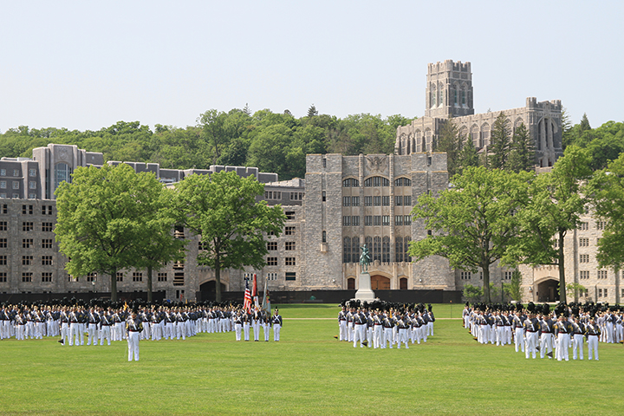


Class Services –Sallyport Overview for Class Leaders
Serving West Point and the Long Gray Line
Notes:
Good afternoon,
This presentation came about because I briefed the Class of 23 last year and it was tailored to them. After, I realized it would be beneficial to have a more generic brief that I could use for all the Class Leaders.
so I am going to go through my slides that I either brief to Class leaders or send before our training. It really depends on the Class, who is coming, and how much time they have. Usually, we go more into Sallyport than the briefing which is why I will send it to them.
I will brief it like you are a class leader.

Slide 2
What is Sallyport?
Sallyport is your connection to your classmates and the Long Gray Line.
It was developed for the AOG as an All-in-One Community Platform.
It’s a combination of website, social media, send emails/messages and place to archive your Class History.
It can be customizable to your class and class needs.
It is a secure site.
All Living Graduates are automatically populated into Sallyport and their Class Page.
All Public WPAOG News and Events can be seen on the ‘Landing Page’.
Notes:
What is Sallyport? Great question. Its your connection to your classmates and the Long Gray Line. It was developed for the AOG .
Unlike Facebook, everyone is included.

Slide 3
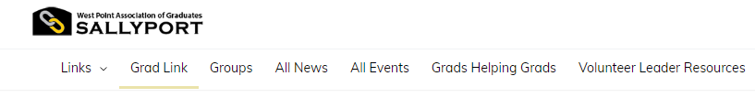
Sallyport Connections
Grad Link:
  You can search Graduates by:
    Name
    Location
    Use the More Filters section to refine your search
Different Types of Groups:
  Class Pages
  Society Pages
  Shared Interest Groups (SIGs), i.e. Glee Club, West Point Women, Entrepreneurs, etc
  Div 1 Athletic Teams

Slide 4
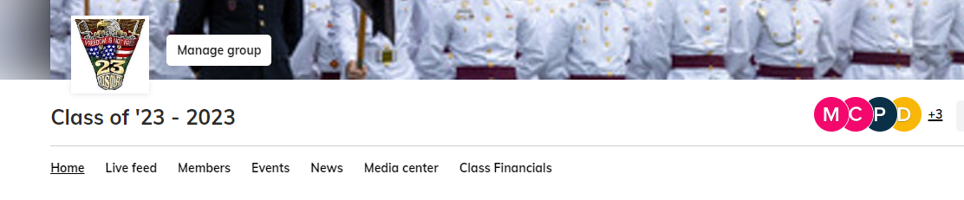
Class Administrators
Every class gets 3 admins. You need to decide who they will be
  Class Digital Media Officer/Information Systems Officer
  Historian (Class Notes)
  President (Emailing the Class)
  Any classmate that wants to be involved
‘Manage Group’ tab is only visible to Admins
‘Class Financials’ tab is only visible to the Class President and Treasurer

Slide 5
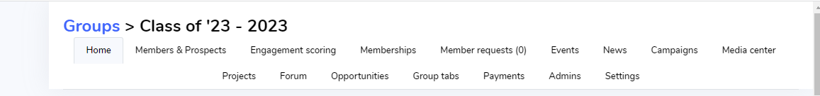
Key Items to Discuss
Members & Prospects
Live Feed
Events (Class Services Stripe Account, 3% processing fee)
News (Class Notes)
Campaigns (Emails)
Update your Profile/Notifications
Class Leader Groups

Slide 6
Members & Prospects
All Living Grads are automatically populated into Grad Link and their Class Pages.
Surviving Spouses are automatically added after the death of the grad and are ‘hidden’ in your Class Page.
Hidden members can see everything in your Class Page.
Associate Members (AMs), Ex-Cadets, and graduates from other class years must be approved by the Class Officers to be in the page.
In the ‘More Filter’ section, users can search for classmates, or by specific criteria to include Cadet Companies, Sports, Locations, Branch, to name a few.
Admins can see everyone in the Back Office (BO) to include Surviving Spouses, AMs and Ex-Cadets.
Admins have a more extensive filter to search based on Roles, User Activity, User Notifications, Activations, etc. It can be exported to an excel spreadsheet.
Notes:
Surviving Spouses: We did this because if they are shown in the Class Page, they are shown in all their group pages. We decided it made sense for their privacy. Class leaders know how to get a hold of them if needed.
Surviving Spouses are not in Grad Link and cannot see Users emails.

Slide 7
Live Feed vs Forums
Live Feed is open to all classes and users.
  One list for every topic
  Scroll through the Live Feed to find a topic
  Upload photos/documents
  ‘Like’ the posts
  Pushed to all activated classmates

Slide 8
Events
Sallyport can be used to plan Class Events.
  Invite classmates to funerals and/or ask for donations.
  Tailgates or Mini-Reunions with their classmates.
  Zoom Meetings.
Keep track of attendance through RSVPs.
Events can only be created by Admins.
A 'How to Create and Event' is in the Class Leader Toolkit.
AOG uses Stripe to process the financial transactions for Sallyport events. Stripe charges attendees a 2.9% plus $0.30 processing fee per transaction. Funds collected for your event will go straight to your AOG Class Admin Fund. Class Services disburses funds to pay your event invoices from the Class Admin Fund according to our existing policies & procedures.
Notes:
They can be free, ticketed to include multi-ticketed.
When you are figuring out pricing, please keep in mind the processing fee. Make sure you put in your class year in the title of the event. Makes it easier to disburse funds to the right class.

Slide 9
News/Class Notes
Class Notes from 2011-2022 have been archived in the 'News' Tab.
Classes can publish ‘News’ or Class Notes here.
Some Classes choose to put .pdf files in their ‘Media Center’ to archive everything.
Some Admins will send the class notes out as emails to their class.
Admins are the only ones who can publish News/Class Notes.
You can choose to make the ‘News’ public which is searchable in different Search Engines and shareable.
Notes:
Search Bill Mullen Farewell

Slide 10
Email Campaigns
Admins can send out Emails through Sallyport. They can choose everyone in the group or 'Filter' who can receive them based on the message.
Emails will go to all individuals in the Class Page. Everyone receives the emails even if they are not activated.
The only exceptions are users who have a 'Do Not Email' code. Their profile will not have a valid email or if they ‘Opt-Out’ of emails/notifications in their Profile.
Check analytics for how many have received and opened the messages. Also, shows emails that have bounced or dropped.

Slide 11
Class Customization (Some Ideas)
Class Crest
Class Leadership
Banner/Cover Photo
Home Page to include video
Different ‘Group Tabs’ dependent on Class needs
  Newsletters
  Be Thou At Peace
  Constitution/By-Laws
Invitation, approval, and rejection emails in your ‘Settings’ tab
Forums
Notes:
Every page starts with the basic tabs. You can change them to fit your needs.

Slide 12
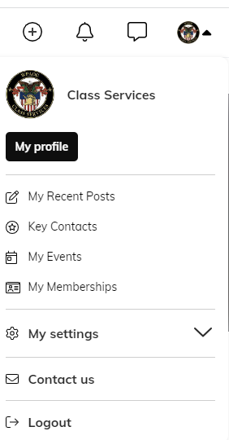
Update Your Profile
The best way to update your information with the AOG is by updating your profile in Sallyport.
To update your Sallyport Profile, login to Sallyport.
  Click on your photo or initials in the upper right-hand corner
  In the drop-down menu, click on My Profile
  You will be on your profile page. Scroll through and click Edit for any section you would like to update.
  Some information can only be updated by an admin, like email addresses.
  Make sure to hit save.

Slide 13
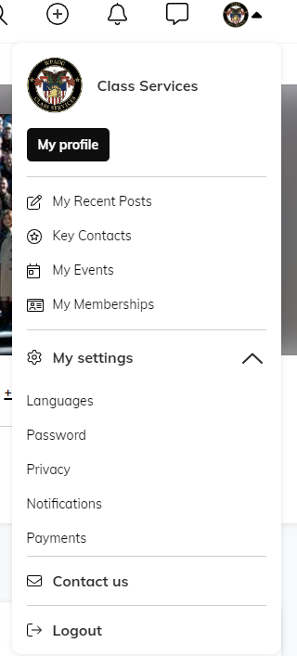
Update Your Notifications
Notifications go out to all activated Group Members unless they have turned them off.
To update your Notifications, click on your initials.
  In the drop-down menu, click on My settings.
  In the next drop-down menu, click on Notifications.
  You can update your General Notifications or click on Group to update your specific Group Notifications.
  Make sure to hit Save

Slide 14
Class Leader Toolkit
WPAOG Class Services – ASCS group page
  It is an open group.
  The Toolkit is located here: https://sallyport.westpointaog.org/topics/11871/page/class-leader-resources.
  Any User can join or 'go to the group'.
  It is a living document that we are constantly updating. If you have ideas, please submit them using the Class Services Bug Tracker.
Resources available:
  Class Rosters
  Update your Class Leadership
  Sections for specific Class Positions
  Schedule Zoom Meetings
  Links to past Leader Conference Slides and Videos
  Information for planning Events
  And Much More!

Slide 15
Class Leader Group
Class Leader Group
  It is a closed group.
  You are automatically added to it as a Class Leader.
  It is also a living document that we are constantly updating. Let us know your ideas.
  The Class Leader Update is sent from this group.
  You can use the Live Feed to ask questions or start discussions.
This is a page just for you!

Slide 16
Bottom Line: Sallyport is what You make of it!
QUESTIONS ???
Contact information:
Stephanie Erickson ‘93
Class Services Sallyport Coordinator
Stephanie.Erickson@wpaog.org
It is my honor and privilege to serve you. I am here to help!!

