Slide 1

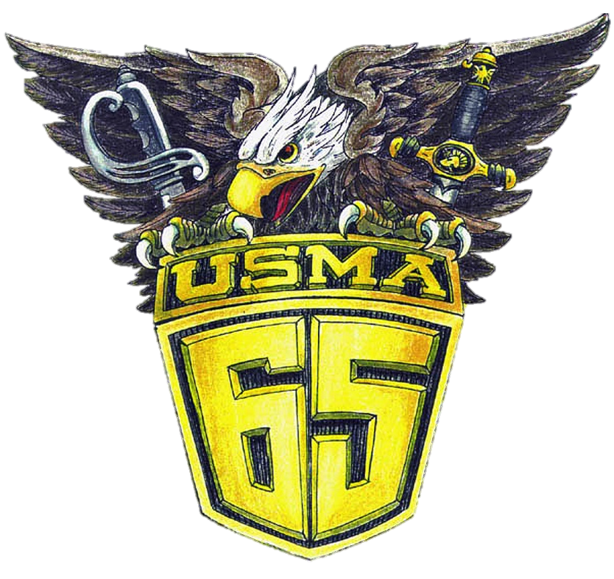
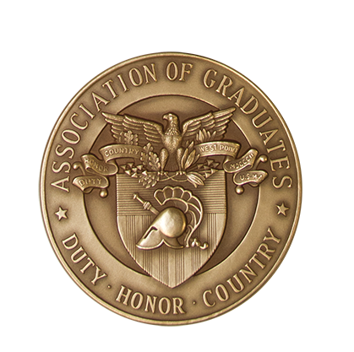

Class Officers:
President: Pat Kenny
Sr Vice President: Fred Smith
Vice President: Denny Coll
Secretary & Scribe: Gerry Buckosky
Treasurer: Mitch Bonnett
Historian: Bob Frank
ISO: Chuck Nichols
Memorial Article Manager: Chuck McCloskey
WPAOG Board of Directors/Advisory Council:
Class Advisor: Jack Jannarone
Reunion Chair:
Mr. Joseph R. Barkley
Mr. Michael P. Lapolla
Distinguished Graduates:
Mr. Joseph B. Anderson Jr.
Mr. Thomas C. Barron
Mr. Paul W. Bucha
LTG (R) Dan Christman USA
LTG (R) Joseph E. DeFrancisco USA
GEN (R) Eric Ken Shinseki USA

Slide 2
Business Meeting Agenda
Memorial Articles
Distribution of Class Gift Fund
Election of Officers

Slide 3
Distribution of Class Gift Fund
Balance as of 3/31/2025: $433,954
SUPT's Unrestricted Fund – 20% ($86,791)
DEAN's Unrestricted Fund - 20% ($86,791)
Center for Oral History Endowment – 15% ($65,093)
CMDT's Unrestricted Fund– 15% ($65,093)
ARMY A-Club Fund – 15% ($65,093)
WPAOG Long Gray Line Endowment – 15% ($65,093)

Slide 4
Committee to Nominate Officers for Class of 1965
for Period 2025 to 2030
Russ Campbell: Chairman & Immediate Past President
Steve Ellenbogen
Dave Hurley
Fred Laughlin
Larry Neal

Slide 5
Class of 1965 Officer Nominees for the Period
of 2025 to 2030
President: Jim Harvey
Sr. Vice President: Bob Wolff
Vice President: Fred Smith
Secretary: Chuck McCloskey
Treasurer: Mitch Bonnett
Historian: Bob Frank
Scribe: Denny Coll
Information Systems Officer: Chuck Nichols

