Slide 1
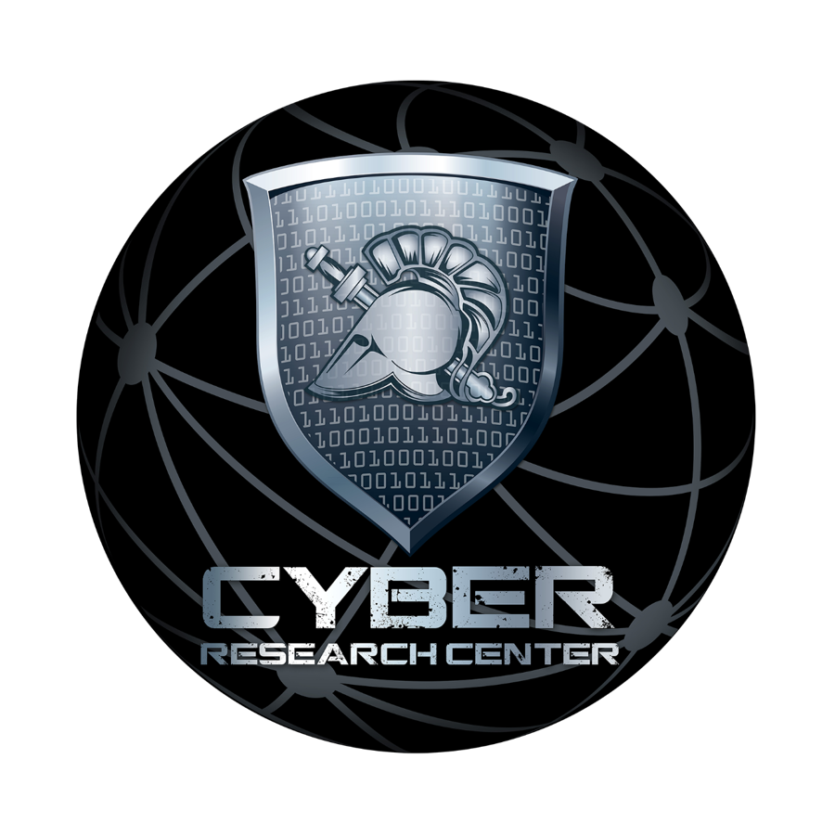
LTC Ray Blaine, Ph.D., P.E.

Slide 2
Overview and Mission
Mission: To educate and inspire cadets in cyberspace operations, find and sustain margin of excellence opportunities for cadets and faculty, and build and maintain ties with Army and national cyberspace operations community to develop the skills of young men and women necessary to fight and win in the cyber domain
Research Priorities
Enhance Cadet Education
Develop Faculty Professionally
Address Important issues facing the Army and Nation
Enhance the Reputation of USMA
Directors
LTC Billodeau | LTC Richbourg | MAJ Harville | LTC Richbourg | LTC Marin | LTC Ragsdale | LTC Dodge | LTC Conti | LTC Lanham | LTC Blaine
85-88 | 88-91 | 91-92 | 93-96 | 97-01 | 01-03 | 03-07 | 07-14 | 14-18 | 18-TBD
1985
Change of Mission & Renamed: Information Technology Operations Center (ITOC)
2012
CRC & ACI Divestiture Complete
Office of Artificial Intelligence Analysis and Evaluation (OAIAE) established, USMA ICW HQDA G2
Change of Mission & Renamed Cyber Research Center (CRC)
EECS & CRC “Create Army Cyber Institute” (ACI)
1997
2014

Slide 3
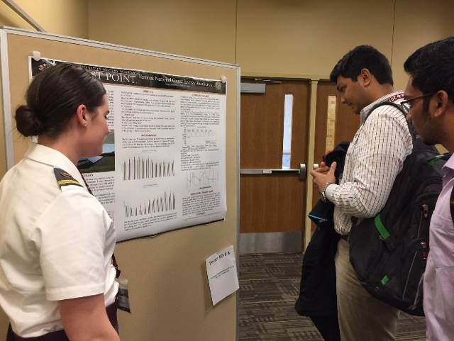
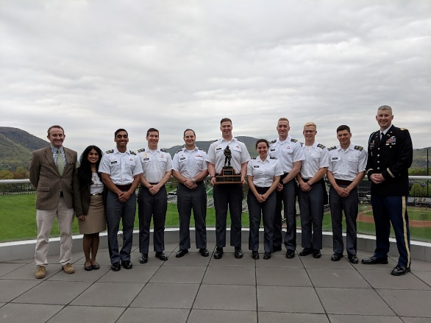
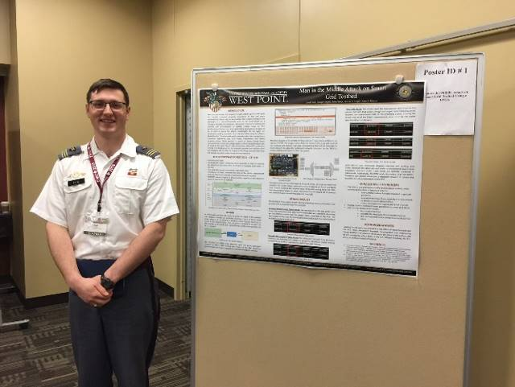
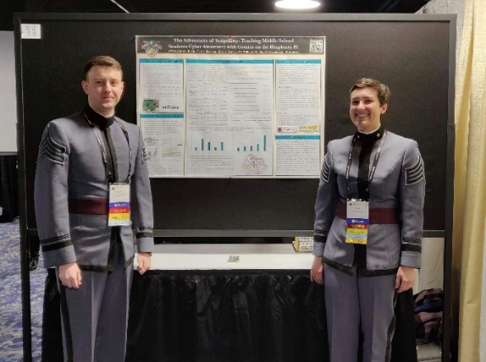
CRC Research - AY19
IEEE Texas Power &Energy Conference (TPEC)
Raspberry Pi Android Security System
CDT Birgitta Anderson – 1st Place in the Poster Competition for “Vermont National Guard Energy Storage Evaluation”
EECS CDTs Ciurtin, David, Dunham, Johnson, and Shyamkumar, – USMA Scott Clark Award for Innovation Winner. Also finalist in MIT design competition
CDT Jared Fritz – 3rd Place in the Poster Competition for “Man-in-the-middle Attack on Smart Grid Testbed using an FPGA”
ACM SIGCSE Conferfence
CDTs Baciu-Ureche and Sleeman – Present the “Adventures of Script Kitty” a project designed to grow the next generation of cyber professionals
All in all, TPEC was a very valuable experience and I hope other EECS students can attend more conferences like this one in the future. “ CDT Birgitta Anderson

Slide 4
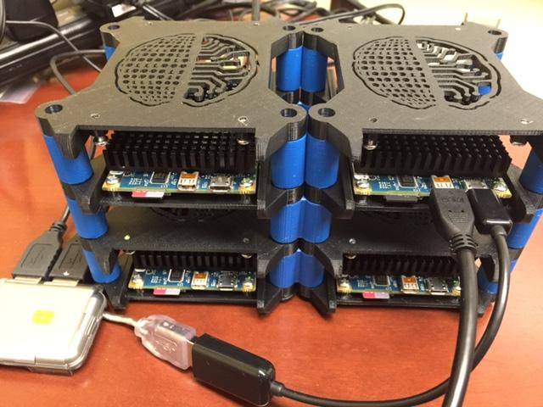
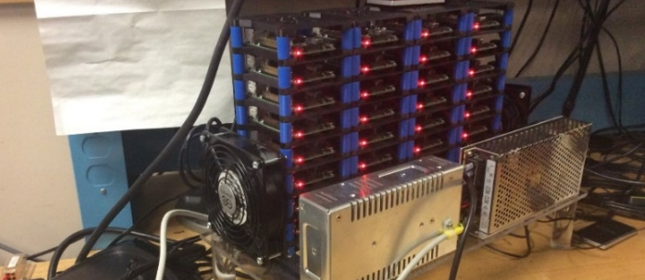
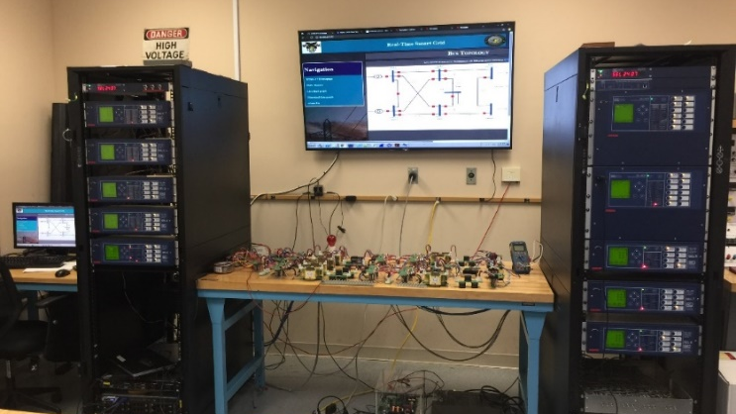
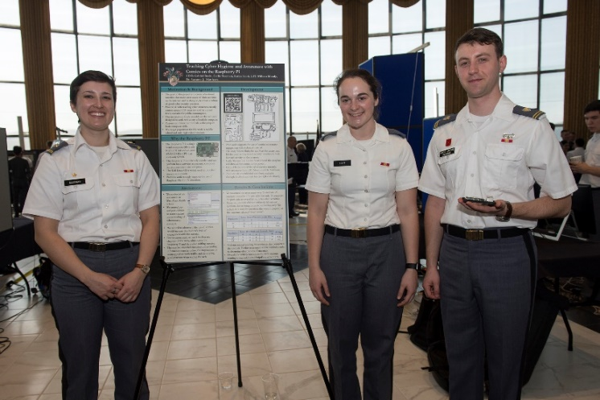
\
Ongoing Research
Parallel & Energy Efficient Computing
Dr. Suzanne Matthews
Cyber Physical System Research
Dr. Aaron St. Leger
37 cadets, 8 faculty
8 posters, 10 papers
3 best paper awards, 1 best poster
5 scholarship winners
Interdisciplinary Projects (CS/EE, CS/MATH, CS/Bio)
19 Research Publications
7 Presentations
Best Paper Awards at
2017 MIT URTC
2017 IEEE UEMCOM
Invited Distinguished Lecture at Lehigh University

Slide 5
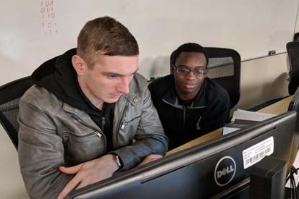
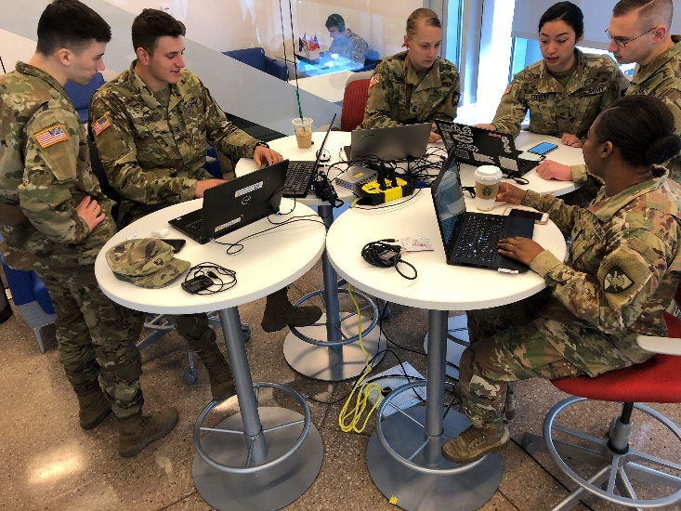
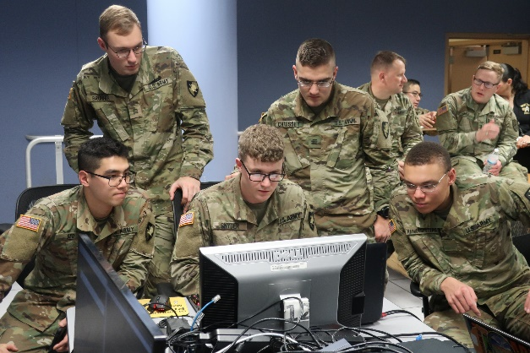
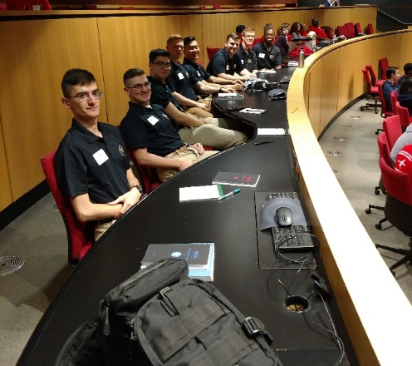
Cadet Competitive Cyber Team (C3T)
Collegiate Cyber Defense Competition: C3T competed in CCDC for the second time. This exposes the Cadets to DCO
Army vs. Air Force Capture the Flag:
First ever “star match” cyber competition created by C3T coaches
NSA Cyber Defense Exercise (NCX)
U.S. Air Force Academy
37 USMA Cadets
All Service Academies and several Universities
4 modules and a culminating force on force event
USMA Finished 3rd this year
2019 SANS Academy Cup:
10 Cadets gave up their Spring Break to attend SANS Training. They got 1st place in NetWars versus the other academies
National Collegiate Penetration Testing Competition:
USMA competed in this competition for the first time. The only service academy to participate

Slide 6
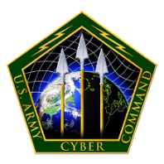
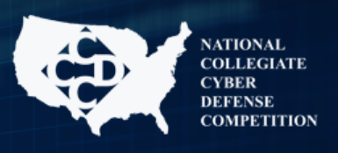
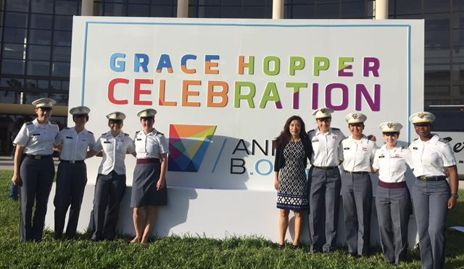
Margin of Excellence
Cadet Internship
Opportunities
Clubs
Conferences & Training
70+ At DoD Orgs Freshman – Juniors
Cadet competitive cyber Team (C3T)
CFT Team
Red Team
Blue Team
ACM SIGSAC
ACM Systers
<10 USG & Allied Orgs Freshman – Juniors
OGA
~70 cadets and 2 Faculty
40+ EE,CS, IT slots at 30⁺ Freshman – Juniors

Slide 7
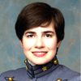
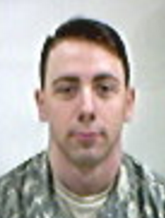
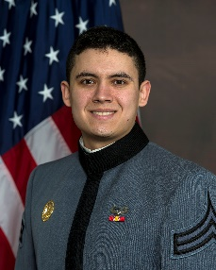
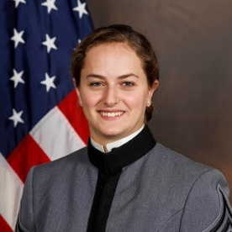
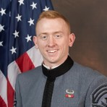
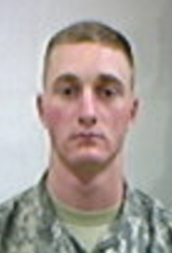
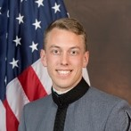
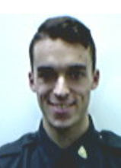
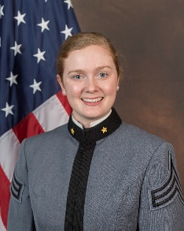
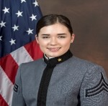
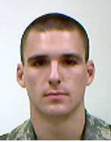
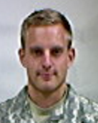
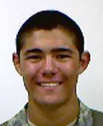
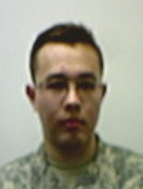
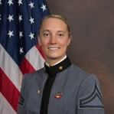
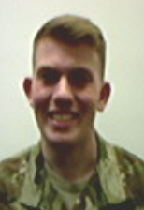
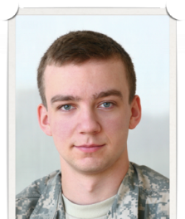
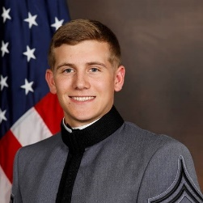
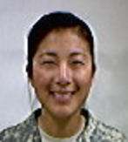
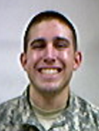
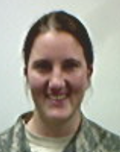
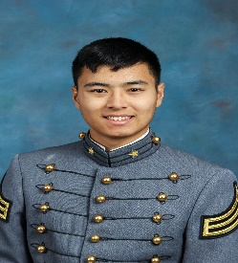
Impacts
Class of 2016
Class of 2017
Class of 2018
Class of 2019
Lisa Jones
Adam
Kratch
Madeleine
Schneider
Outstanding Undergrad Researcher, Female Awardee
Computing Research Association
Andrés Alejos
James Tyler
Harvard
University
Northeastern
University
Purdue University
Churchill Scholarship winner;
NSF Graduate Fellowship awardee
GEM scholarship
Marshall Scholarship
Winner
Tyler Reece
Leonard
Kosta
Boston University
Robert
Koehlmoos
Jakub
Smola
Jack
Graham
Samuel Miller
Mary
Pollin
Richard
Shmel
Boston University
MIT
Draper Laboratory
Fellows Program
Birgitta
Anderson
Draper Laboratory Fellowship
MIT
Northeastern
University
Draper Fellow
Anna
DeVries
Cyber Branch, Advanced Civil Schooling
Connor Mullen
Kyle Fauerbach
Northeastern
University
Northeastern
Northeastern
Matthew
Yuan
Jinny
Yan
Neil
Eichenberg
Austin
Herrling
MIT
Joseph
Schlessinger
Wilahelm Wan
MIT
MIT
MIT Lincoln Labs Military
Fellowships
Draper Labs
Fellowship
Hannah Whisnant
Lincoln Laboratory Military Fellowships
Lincoln Lab Fellows

Slide 8
Questions

